Slide 1
Introduction To Agile and Scrum

Slide 2
Bruce Nix, CSP, CSM, MCP, MCTS
Scrum and Iterative Implementations
Herff Jones – Currently working with Pilot Team
AutoZone - Doubled feature releases and project close rate
Accredo – Enterprise Scrum Competency Center
Lokion – eCommerce B2B replatform
Scripps Networks Interactive – Agile Adoption for HGTV, Food Network, Fine Living
Merry Maids – Proprietary Desktop Software rewrite to Enterprise Web Application
Blah, Blah, Blah
Founding Member of Memphis Agile Practitioners Group
Speaker at local chapters (PMI, IIBA) on Agile topics
Contributed material and feedback for Stephen Denning’s book The Leader's Guide to Radical Management: Reinventing the Workplace for the 21st Century.
Master of Science, Computer Information Technology (Software Engineering, Database Technologies)
BS, Organizational Management

Slide 3


Legend
Self-Directed research for further insight and knowledge growth
Agile worthy reference material

Slide 4
What Seems To Be The Problem?

Slide 5
Traditional Project Approach
Whole project is planned up front
Assumes the customer can definitely know, articulate and functionally understand what the system or software should do at the end of the project.
Assumes that, once documented, the requirements will not change – at least not without potential project delays, budget overruns or stunted feature sets.
Assumes that the requirements process is confined to a sponsor who sits apart from the development team envisioning the product.
Does not acknowledge the inherent uncertainty in software development.

Slide 6
Why Try Something Different?
“If you don’t like change, you’re going to like irrelevance even less.” - Retired U.S. Army General Eric Shinseki

Slide 7
Reasons For Using Agile Methods
Increased collaboration of business and IT teams
Increased visibility
Shorter development cycles
Progress is measured by tested and working software
Frequent inspection cycles

Slide 8

Minimum Form, Maximum Freedom
Strategy
Vision associated with business need
Strategic goals and objectives
Release
Delivery Cycle(s): 1-6 Months
Iteration
Sprint/Iteration: 2-4 weeks
Release Plan
Defined set of prioritized features
Demo/Review
Retrospective
Daily review of progress and impediments
Daily
Completion of highest priority features
Continuous
Adaptive Planning, design, development and testing
Integration
Refactoring
Five Levels of Planning
Notes:
- AKA 5 Stages Of Planning

Slide 9
AGILE
SCRUM - 55%
SCRUM/XP Hybrid - 11%
Custom Hybrid - 10%
ScrumBan – 7%
Kanban– 5%
Lean – 3%
Feature Driven Development – 2%
Feature Driven Development
Kanban for Development
Lean Software Development
Notes:
2013 8th Annual State of Agile Survey - http://www.versionone.com/pdf/2013-state-of-agile-survey.pdf?
Additional Kanban References - http://www.kanbanblog.com/explained/

Slide 10
Techniques Used
Notes:
- 2013 8th Annual State of Agile Survey - http://www.versionone.com/pdf/2013-state-of-agile-survey.pdf?

Slide 11
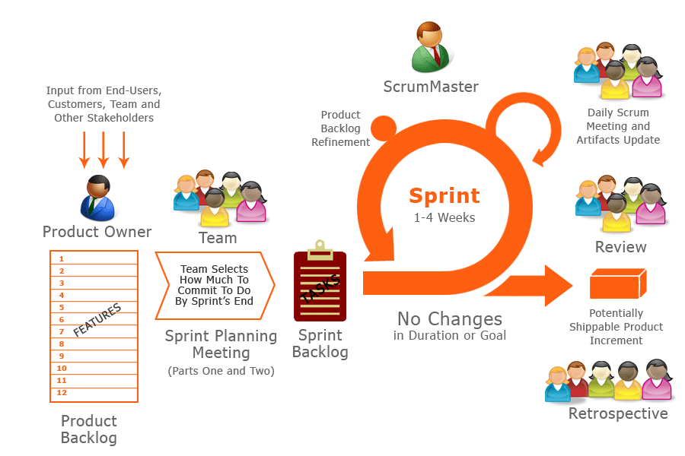
Scrum Approach: Simple To Understand
2013 Scrum Guide

Slide 12
Roles & Responsibilities
Product Owner
Scrum Master
Scrum Team

Slide 13
User, Customer, Executive
Product Owner
Keeper of the vision for product
Responsible for the product, ROI and features
One per team
Stays one sprint ahead of the team
Respects team estimates
Communicates often
Plans and prioritizes continuously
Attends every release, sprint planning session and sprint review
Product Owner Overview
PO Responsibilities
Agile Product Management
Notes:
- Single Wringable neck

Slide 14
Feature Delivery
Scrum Team
Typically 5-10 people
Cross-functional
QA, Developers, UI Designers, etc.
Plan their own work
Have the authority to do what is needed to meet their commitments
Self-organizing
Commit to the sprint
Own the estimates
Rely on the Scrum Master to remove obstacles
Self Organized Teams
Tribal Leadership

Slide 15
Protect the Team
Scrum Master
Not the decision maker
Cannot commit to dates and budgets
Facilitates the team and listens
Responsible for enacting and protecting Scrum values and practices
Main job is to remove impediments
Works with Product Owner to groom product backlog and prioritize features

Slide 16

Strategy Meeting
Purpose ::
Articulate project vision and strategy
Define goals, objectives and details for roadmap
Inputs
Understanding of existing strategy, projects and technologies
Outputs
Agreed-upon vision for product or project
High level goals and objectives
Obstacles
No defined vision
Strategic plan disagreement
Critical dates
Decision makers not present
Rough cut product backlog
Frequency :: 1 -2x a year with updates as needed
Duration :: 4h – 2d

Slide 17
Release Planning
Purpose ::
Define priorities and target delivery dates identified
Release backlog created and estimated at a high level
Inputs
Vision and strategy
Outputs
Feature release plan
Prioritized backlog
Obstacles
Unable to balance time, scope and budget constraints
Not trusting team estimates and release plans
Assumptions and issues
Inability to accept plan is not frozen and change will occur
Project goals and plans
Prioritized product backlog
Target milestone dates
Estimated delivery dates
Estimated team capacity
Frequency :: First day of each planned release
Duration :: 4h – 8h
Notes:
A list of all desired work on the project
Usually a combination of
story-based work (“let user search and replace”)
task-based work (“improve exception handling”)
List is prioritized by the Product Owner with help from Scrum Master and Team

Slide 18
Notes:
Actual Release Plan from Scripps Networks

Slide 19
Sprint Planning
Purpose ::
Plan and agree on what can be accomplished during the sprint
Plan and agree on how it will get done, and complete sizing
Inputs
Prioritized backlog
Outputs
Sprint goal
Task estimates for prioritized user stories
Obstacles
Attempting to put too much detail and design into each story/feature.
Dependencies not minimized
Acceptance tests
Having “wallflower” or “anchor” team members
Team capacity
Schedule risks
Frequency :: First day of each planned sprint
Duration :: 2h – 4h
Notes:
Planning session includes story building (Identification, sizing, prioritization)
Task exploration (what is needed to meet story goal, assigning estimates)
Team Commitment
Parking lot review (issues, prioritization)
Horizon View (demo, retrospective and next planning session)
-Scrum team takes the Sprint Goal and decides what tasks are necessary
-Team self-organizes around how they’ll meet the Sprint Goal
Manager does not assign tasks to individuals
-Managers don’t make decisions for the team
-Sprint Backlog is created
-Changes
Team adds new tasks whenever they need to in order to meet the Sprint Goal
Team can remove unnecessary tasks
But: Sprint Backlog can only be updated by the team

Slide 20
Here’s A Story…

Slide 21
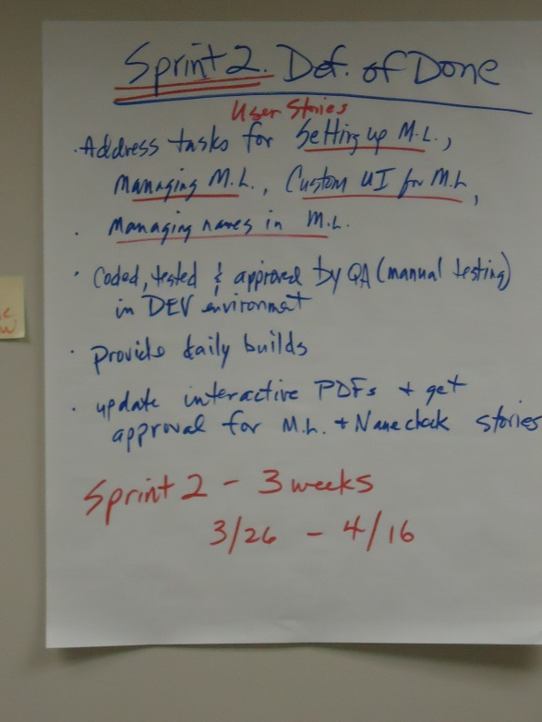
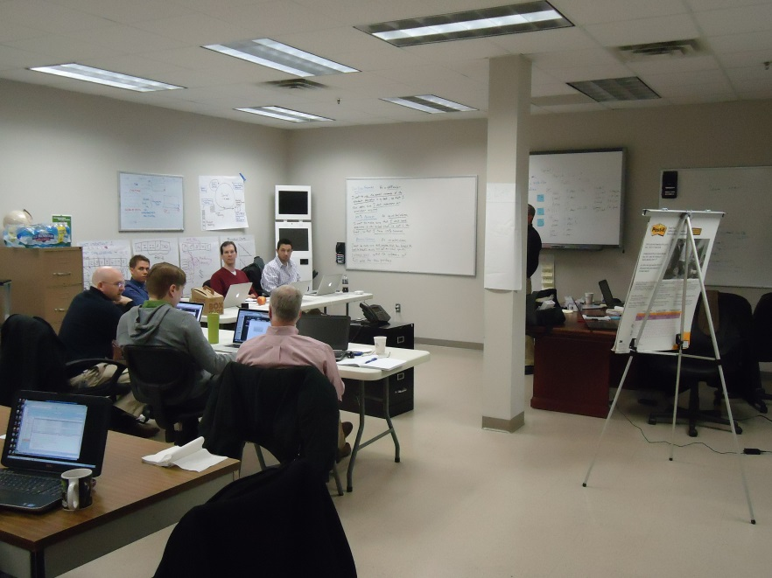
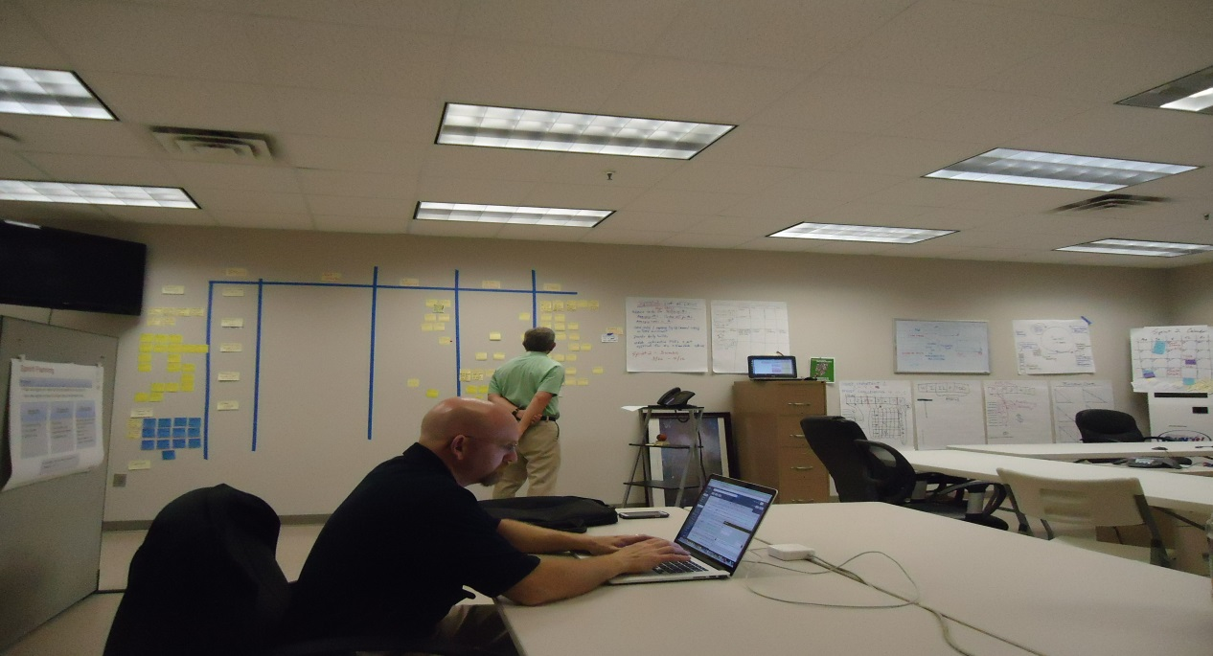
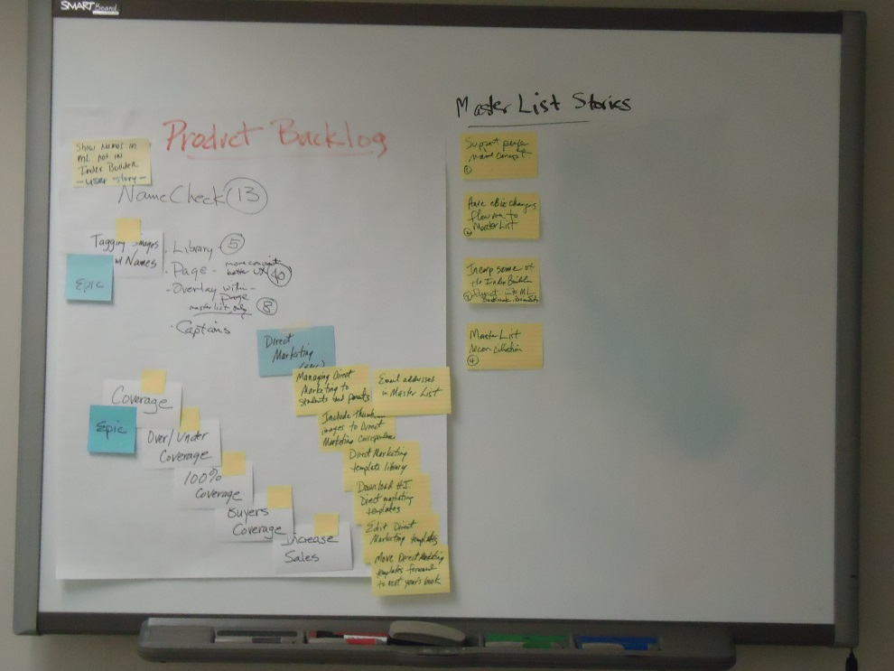
Herff Jones Team

Slide 22
User Stories
A way of defining requirements (Business, User and System) in a helpful contextual manner, expressed in everyday language
BR Statement | Story
The system shall allow users to authenticate using a unique username and password to gain access to application | As A User I WANT to identify myself with a unique username and password SO THAT only I will be able to change my information

Slide 23
User Story Format
Format | Description
AS A | <User Type> Business Role – Product Owner, Customer, Stakeholder, User, Vice-President
I WANT (Must Have, Should have, Could Have) | <Functionality, Feature, Characteristic> - Administration Page - Ability to add a follow-up flag
SO THAT | <Business Value Provided> Answers the Why we are doing this - If it is hard to answer, feature is probably not needed

Slide 24
User Story Format – Verify Doneness
Format | Description
GIVEN | <Pre-Condition> State of the system at the beginning of the test - States Assumptions - Add additional pre-conditions as needed
WHEN | <Event Occurs> - Event that will trigger an outcome
THEN | <Expected Outcome> Expected outcome of event(s) - Add additional outcomes as needed
Notes:
- Other ways of testing

Slide 25
User Story Format – Verify Doneness
Story
As A User I WANT to identify myself with a unique username and password SO THAT only I will be able to change my information Scenario 1: Username and Password are available and correct username and password are provided. GIVEN: Username is present in system AND: Password is present in system WHEN: User provides correct username and password THEN: User profile is displayed

Slide 26

Daily Stand Up
How does a project get to be a year late? One day at a time.
– Frederick Brooks, The Mythical Man-Month
Purpose ::
Facilitation of team communication
Inputs
Individual team members state of work
Outputs
Task progress
Task burndown
Obstacles
All team members not present
General discussion occurs vs. Targeted progress
Non-team members derail stand up with side conversations
Identified obstacles to completing work
Critical issues and obstacles
Issue resolution vs. Issue identification
Frequency :: Every day of sprint, same time, same location
Duration :: 15m
Notes:
Parameters
Daily
15-minutes
Stand-up
same place and same time
Not for problem solving
Three questions:
What did you do yesterday
What will you do today?
What obstacles are in your way?
Stakeholders can be invited to observe, but are not allowed to talk
Only team is allowed to talk
Why daily?
“How does a project get to be a year late?”
“One day at a time.”
Fred Brooks, The Mythical Man-Month.
Can Scrum meetings be replaced by emailed status reports?
No
Entire team sees the whole picture every day
Create peer pressure to do what you say you’ll do

Slide 27
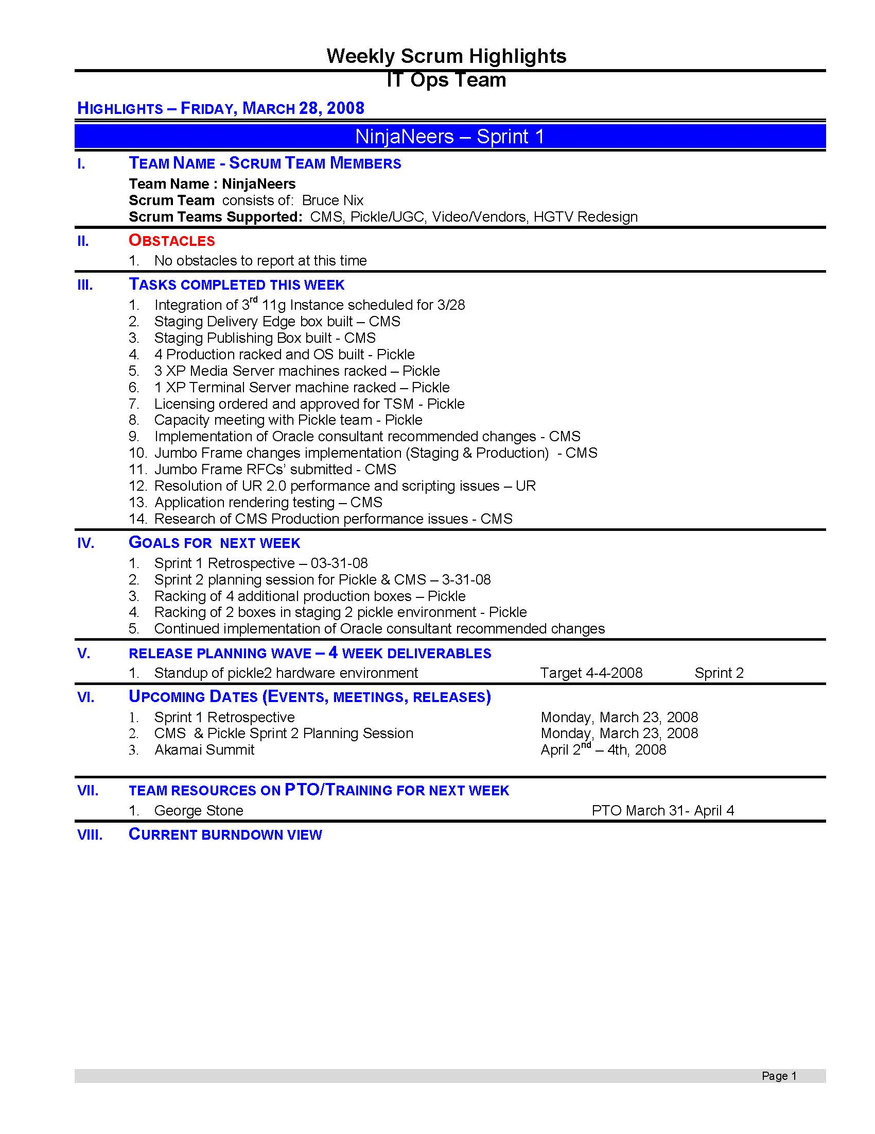
Weekly Scrum of Scrums
Notes:
Scrum of Scrums replaced weekly status meetings
Stakeholders were invited and could listen to the status of organizational updates rather than just one product to identify opportunities or areas to eliminate redundant work

Slide 28
Sprint Review (Demo)
Purpose ::
Acceptance criteria has been met
Demonstration of completed working functionality
Definition of Done has been met
Inputs
Working product set
Outputs
Acceptance of product set
Incomplete items addressed
Obstacles
PowerPoint demo of software
Non-acceptance of product set
Tested product set
Product backlog massaged and prepped
DoD not clear
Frequency :: Last day of sprint
Duration :: 1h – 2h
Notes:
Team presents what it accomplished during the sprint
Typically takes the form of a demo of new features or underlying architecture
Informal
2-hour prep time rule
Attendees
Team
Customers
Management
Product Owner
All other interested parties

Slide 29
Are We Done Yet?
Producing production-ready quality software every sprint takes:
• Discipline
• Pursuit of excellence
• Intense and effective collaboration
• Common definition of done - A user story is 100% ready to deploy to production when;
Accepted by product owner
All automated unit tests pass with coverage at 85% - 100%
All automated acceptance tests pass
Any additional QA testing has passed
Code is checked-in, integrated and builds successfully
Code compiles and has a simple, well factored design without duplication
Code is clean and structured to coding standards
Code has been peer reviewed
Code is self-documenting and clearly communicates developers’ intentions

Slide 30
Sprint Retrospective
Purpose ::
Evaluation of progress and processes
Inputs
Accomplishments of current and prior sprints
Outputs
Prioritized issues and obstacles
New process improvement
Obstacles
Not all team members participate
List of issues and obstacles from current and prior sprints
First thing teams typically start scaling back on
Frequency :: Last day of sprint
Duration :: 1h – 2h
Notes:
Inspection of process and team practices at the end of every sprint
Attended only by the delivery team
Scrum master facilitates
What went well, what could be improved
Prioritize improvements based on team direction
Team devises a solution to its biggest problems
Scrum Master and team track chosen improvements

Slide 31
Is There A Better Way?
“ There is always a better way
You might have it
I might have it
Someone else might have it
But it’s there
Our job is to find it
When we do find it, we must try it
If it works, then we will go with it
Then we begin searching for an even better way
If it doesn’t work, then we abandon it and try something else
We keep trying until we have exhausted all new ideas
Then we search for even more new ideas
Thus, life is an endless search for a better way
Edison had 9,990 failures before he invented the light bulb
Eventually, he found a better way”
- James E. Clary
Notes:
- Goal of every retrospective is to find a better way

Slide 32
Sprint Retrospective
What did not go well? |  |  |  |  |  |  |  |  | Where can we make improvements? |  |  |  |  |  |  |  | What went well?
Not all groups were available or represented to active tasks that were included in sprint |  |  |  |  |  |  |  |  | Continuous communication amongst team |  |  |  |  |  |  |  | maintenance windows better (communication)
for any issues that are ongoing, communicate to team until resolution |  |  |  |  |  |  |  |  | All groups that have represented tasks need to be available and involved in daily stand up to communicate important items |  |  |  |  |  |  |  | working well together over geographical boundaries
No communication from represented groups that have tasks |  |  |  |  |  |  |  |  | better communication of important dates (release, production, etc) |  |  |  |  |  |  |  | Team is meshing well and quick to respond to calls for help

Slide 33
Putting It All Together

Slide 34
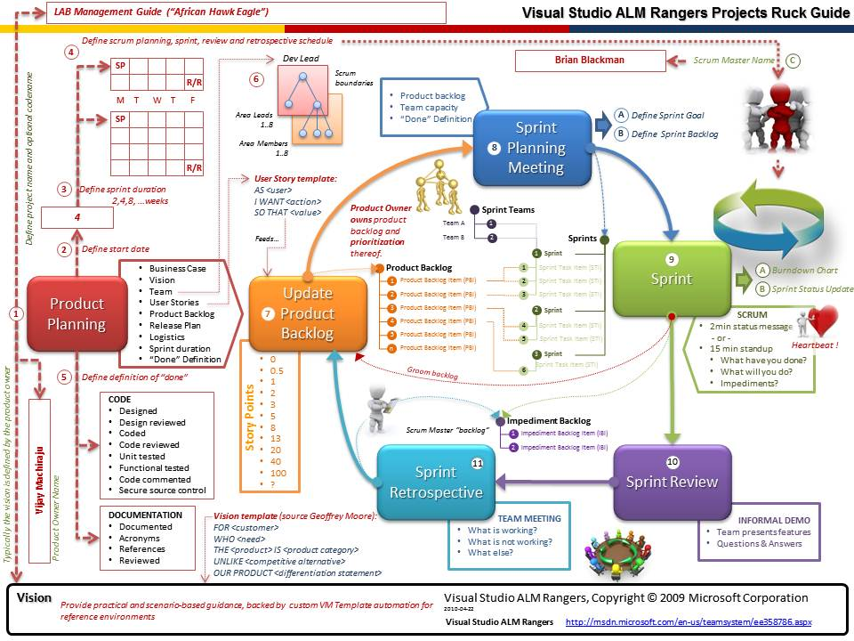
Difficult To Master
Notes:
When you put it all together, it takes focus and discipline to master scrum/agile practice

Slide 35
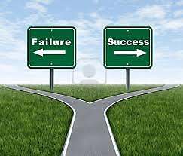
Reasons for…
Company Philosophy
Increased Productivity
Pressure to Follow Waterfall
Higher Quality
Organizational Problems
Increased Business Satisfaction
Unwillingness To Learn
Shorter Development Cycles
Lack of Management Support
Shorter Feedback loops
Insufficient Training
Increased Morale
Results In
Executive Support
Results In
User Involvement
Lacking…
High Degree…
Optimization
Notes:
3 Areas that are the most impactful to project success - http://versionone.com/assets/img/files/ChaosManifesto2013.pdf

Slide 36
Appendix

Slide 37
You really should not mess with people who issue manifestos
Manifesto for Agile Software Development
Individuals and interactions over processes and tools
Working software over comprehensive documentation
Customer collaboration over contract negotiation
Responding to change over following a plan
That is, while there is value in the items on the right, we value the items on the left more.
Notes:
www.agilemanifesto.org
http://www.ambysoft.com/essays/agileManifesto.html
Created in 2001 by many well known authors and experts in their fields

Slide 38
1. Agile Principles
Highest priority is to satisfy the customer through early and continuous delivery of valuable software.
Deliver working software frequently, from a couple of weeks to a month.
Working software is the primary measure of progress.

Slide 39
2. Agile Principles
We welcome changing requirements, even late in development. Agile processes harness change for the customers competitive advantage.
Business people and developers must work together daily throughout the project.
Build projects around motivate individuals. Give them the environment and support they need, and trust them to get the job done.

Slide 40
3. Agile Principles
The most efficient and effective method of conveying information to and within a development team is face-to-face conversation.
Agile processes promote sustainable development. The sponsors, developers, and users should be able to maintain a constant pace indefinitely.
The best architectures, requirements, and designs emerge from self-organizing teams.

Slide 41
4. Agile Principles
Continuous attention to technical excellence and good design enhances agility.
Simplicity – the art of maximizing the amount of work not done – is essential.
At regular intervals, the team reflects on how to become more effective, then tunes and adjusts its behavior accordingly.

Slide 42
User Stories - INVEST
Independent – Stories are easiest if they are independent with little to no overlap
Negotiable – It is not an explicit contract for features, capture essence not details.
Valuable – We care about the value to the customer (As A Role)
Estimable – A good story can be estimated, not exact, but good enough to help the product owner rank and schedule the story.
Small – Small stories can be delivered quickly, thereby receiving feedback quicker
Testable – Writing tests early and often ensure quality stories, thereby, features are being implemented. If you don’t know how to test it, it is probably ambiguous and needs further detail or conversation with customer.

Slide 43
Design and Sprint 0
Time boxed Iteration prior to starting development sprints
Recommendation is for JAD Session to flesh out design details in shorter time
Typically used for Complex Design (UI, Architecture)
Goal is to always be 1-2 sprints ahead of the development team to eliminate delay and wait time

Slide 44
Suggested Reading List
Agile Methodologies
Agile Software Development with Scrum, Ken Schwaber and Mike Beedle, Prentice Hall, 2001
Extreme Programming Explained, Kent Beck, Addison Wesley, 1999
A Practical Guide to Feature-Driven Development, Stephen Palmer and John Felsing, Prentice Hall, 2002
Lean Software Development, Mary and Tom Poppendieck, Addison Wesley, 2003
Agile Project Management
Agile Estimating and Planning, Mike Cohn, Prentice Hall, 2005
Agile Project Management, Jim Highsmith, Addison Wesley, 2004
Agile Project Management with Scrum, Ken Schwaber, Microsoft Press, 2004
Planning Extreme Programming, Kent Beck and Martin Fowler, Addison Wesley, 2000
Agile Retrospectives: Making Good Teams Great, Esther Derby & Diana Larsen, Pragmatic Bookshelf, 2006
User Stories
User Stories Applied: For Agile Software Development, Mike Cohn, Addison Wesley, 2004
Development Practices/Tools
FitNesse
TDD By Example
General Reference
Scrum Guide
2013 Chaos Manifesto
Agile Samurai, Jonathan Rasumusson, Pragmatic Bookshelf, 2010

Slide 45

Lokion is a proven, nimble team of experts crafting digital solutions that work for real people.

Slide 46
Client Sampling
AutoZone
Viking Range Corporation
FedEx
International Paper
Memphis Grizzlies
First Tennessee / First Horizon
Hilton
Nokia
Deluxe Corporation
Hewlett Packard
FedEx Institute of Technology
Smith & Nephew
ServiceMaster Clean
AmeriSpec
National Ornamental Metal Museum
FedEx Kinko’s
Accredo
Lightyear Capital
Harrah’s
eDiets.com
David Lusk Gallery
Cellular South
Jeppesen
Scripps Network
Stephens
Mimeo.com
Rhodes College
Luminetx Corporation
Strategic Financial Services
SRA/Environmental Protection Agency
Cap Gemini
Horizon Ag
mbi
Bridges

